Slide 1

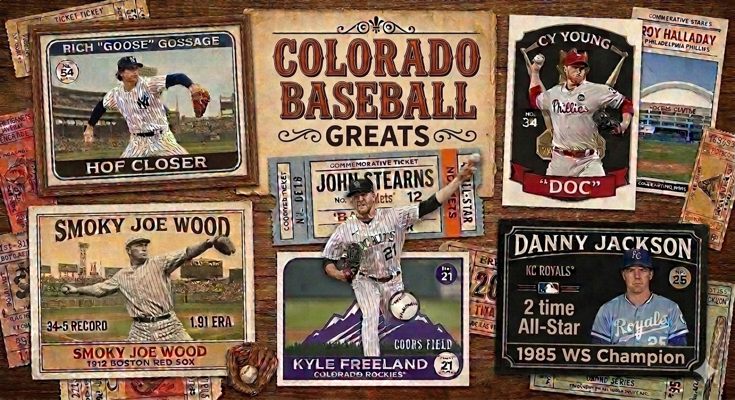

PEAK PERFORMANCE
MLB Players From the Centennial State

Slide 2
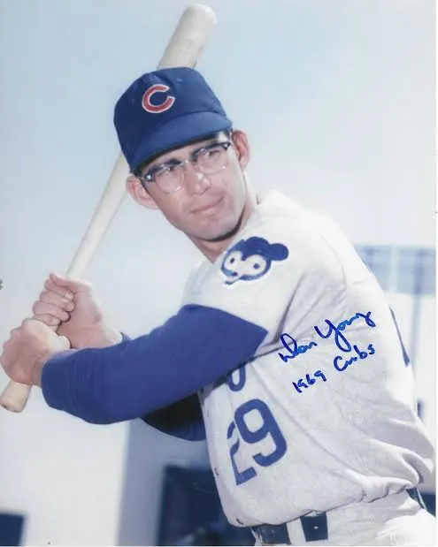
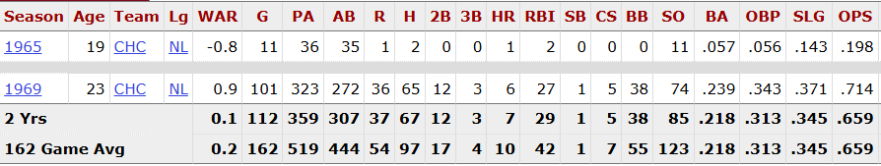
DON YOUNG - AURORA CENTRAL H.S.

Slide 3
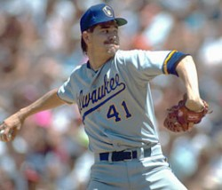
MARK KNUDSON - DENVER
NORTHGLENN HIGH SCHOOL (1974-1978)
COLORADO STATE UNIVERSITY (1979-1982)
DENVER ZEPHYRS (1991)
COLORADO ROCKIES (1993)

Slide 4

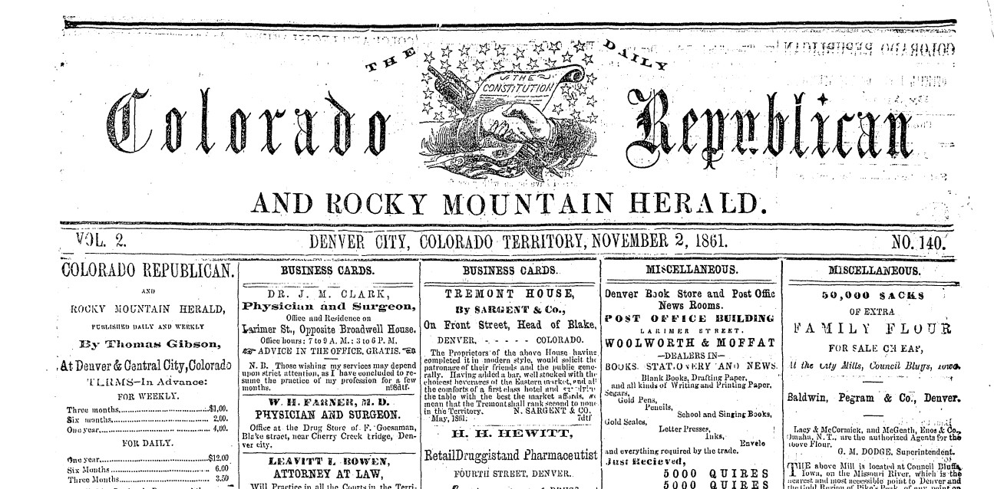
COLORADO BASEBALL HISTORY BEGINNINGS
1861 – COLORADO’S FIRST DOCUMENTED BASEBALL GAME
“We noticed yesterday [so, Colorado’s first documented baseball game was played on Nov. 1] the members of Capt. Downing’s company engaged in the exhilarating game of base-ball.
This is excellent exercise for the muscle, besides being good amusement, and all our soldiers would receive benefits by indulging in this pleasant mode of training.” The Denver Daily Colorado Republican and Rocky Mountain Herald, Nov. 2, 1861.
[Downing’s unit was company D, 1st Colorado Volunteers.]

Slide 5
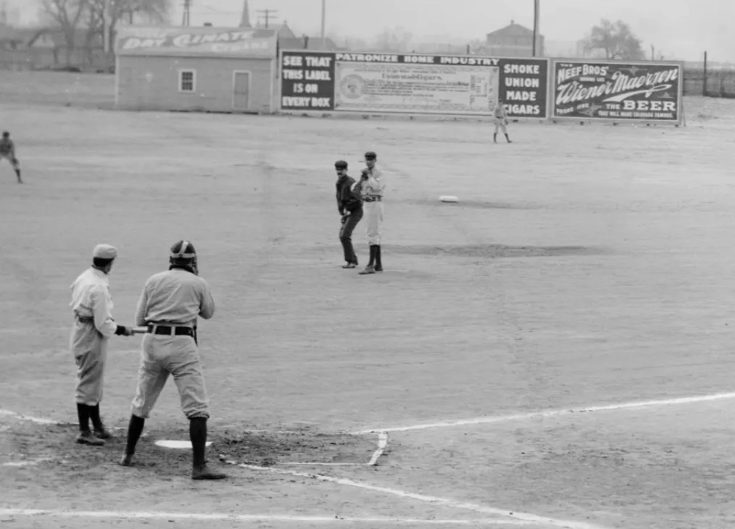

COLORADO BASEBALL HISTORY BEGINNINGS
1862 – FIRST GAME PLAYED WITH DENVER RESIDENTS
The Denver Rocky Mountain News, March 14, 1862: “There will be a game of base ball tomorrow afternoon, commencing at three o’clock, near the Court House, West Denver.”

Slide 6
COLORADO BASEBALL HISTORY BEGINNINGS
First club formed: the Denver Base Ball Club, on March 29, 1862. Subsequent clubs born in Colorado before 1870 included, in ascending order of formation, those in Valmont, Central City, Black Hawk, Julesburg, and Boulder.
1870s: Colorado Springs, Pueblo and many other amateur clubs launched in this decade; in ascending order: River Bend, Greeley, Longmont, Georgetown, Golden, Fort Lyon, Fairplay, Fort Collins, Trinidad, Canon City, and Saguache.
Barnstorming in 1870’s – Cap Anson and Al Spaulding played in Denver and Colorado Springs.

Slide 7
COLORADO BASEBALL HISTORY BEGINNINGS
1885: Colorado State League formed as a professional, unaffiliated circuit of three cities: Denver, Pueblo, and Leadville. Denver plays in its newly constructed Larimer Street Grounds.
1886: Denver joined the Western League, capturing the pennant and commencing a long if interrupted history with the circuit, sometimes called the Western Association. Leadville finished third.
1887: Denver stays in the Western League, but Leadville does not. Major league clubs began to play exhibitions in Denver, with Chicago coming to town in 1886 and the Phillies in this year.
1888: On October 20, Albert Spalding’s World Tourists (the Chicago and All-America clubs) departed Chicago by rail for San Francisco, where they would commence their sea journey. Along the way, they played exhibition games in Denver and Colorado Springs. The first game in the state featuring only current major-league players took place in Denver on Oct 27, with the Chicago’s defeating the All Americas before a crowd of 7,500.

Slide 8
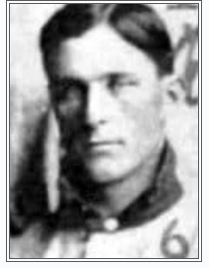
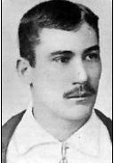
EARLY COLORADO MAJOR LEAGUE PLAYERS
FRANK MARTIN - (1897-1899) - DENVER
JACK BRENNAN - (1884-1890) – FRUITA MONUMENT HS

Slide 9
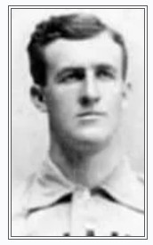
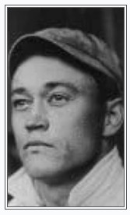
EARLY COLORADO MAJOR LEAGUE PLAYERS
ALBERT “COWBOY” JONES - (1898-1901) - GOLDEN
RALPH GLAZE - (1906-1908) – STATE PREPATORY HS, BOULDER

Slide 10
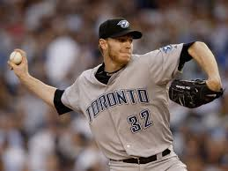
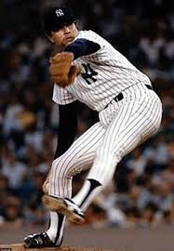
COLORADO NATIVE HALL OF FAMERS
ROY HALLADAY (1998-2013) – ARVADA WEST H.S.
8X ALL-STAR, 2X CY YOUNG AWARD WINNER, 2 NO-HITTERS
ELECTED TO HALL of FAME IN 2019
RICH “GOOSE” GOSSAGE – CO SPRINGS (1972-94)
9X ALL-STAR, 310 CAREER SAVES, 3 WORLD SERIES
ELECTED TO HALL of FAME IN 2008

Slide 11
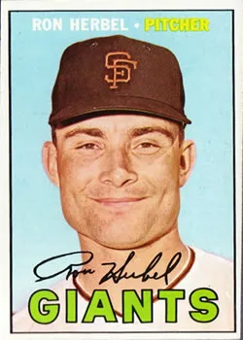
RON HERBEL - BRIGHTON HIGH SCHOOL
Spent nine seasons in the Major Leagues. He pitched for the San Francisco Giants from 1963-69: the San Diego Padres and New York Mets in 1970 and the Atlanta Braves in 1971.
In 1961 with the PCL Champion Tacoma Giants, he posted a 16-5 won-lost record and had a 3.57 ERA and 114 strikeouts.
Had six hits in 206 Major League at-bats for a .029 average, the lowest in Major League history for a player with at least 100 at-bats.

Slide 12
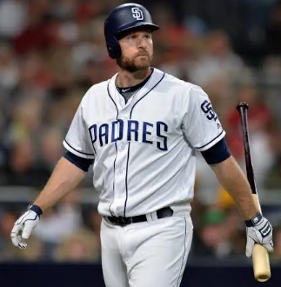
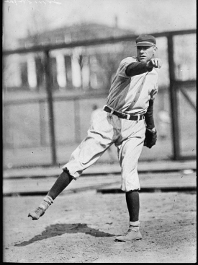
COLORADO ALL-TIME STATISTICAL LEADERS
CHASE HEADLEY – FOUNTAIN, CO - (2007-2018)
Headley career leader in Hits, Runs, HRs, RBIs, Doubles and WAR
Hughes is career leader in ERA (2.56)
TOM HUGHES – COAL CREEK, CO - (1906-1918)

Slide 13
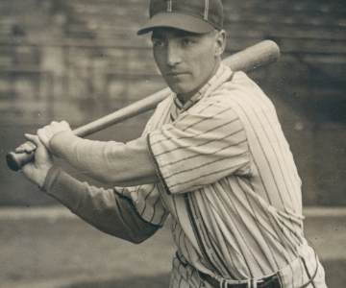
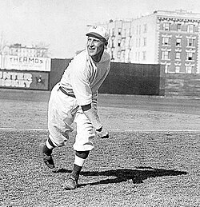
COLORADO SINGLE SEASON STATISTICAL LEADERS
JOHNNY FREDERICK – (1929-1934) - DENVER
Frederick leader in Hits, Runs, Batting Avg, Doubles and OPS (1929, 1930)
Hartzell 2nd highest single season leader with 26 Stolen Bases (1913)
ROY HARTZELL – (1906-1916) – GOLDEN HS

Slide 14
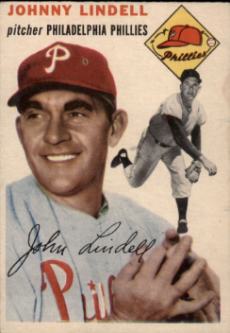
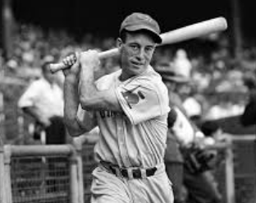
COLORADO SINGLE SEASON STATISTICAL LEADERS
JOHNNY LINDELL – (1941-1954) - GREELEY
Lindell leader in OBP and Triples Doubles (1944, 1948)
Myatt single season leader in SBs and all-time career leader in OBP
GEORGE MYATT – (1938-1947) - DENVER

Slide 15
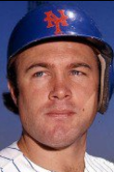
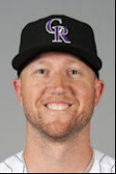
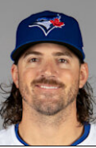
SUBJECTIVE “TOP 25 LIST”
JOHN STEARNS - DENVER (1974-1984)
KYLE FREELAND - DENVER (2017-PRESENT)
KEVIN GAUSMAN – CENTENNIAL (2013-PRESENT)

Slide 16
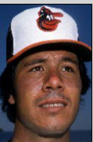
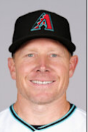
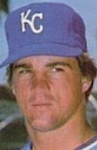
SUBJECTIVE “TOP 25 LIST”
TIPPY MARTINEZ – (1974-1988) – LA JUNTA
MARK MELANCON – (2009-2022) – GOLDEN HS
DANNY JACKSON – (1983-1997) – AURORA CENTRAL HS

Slide 17
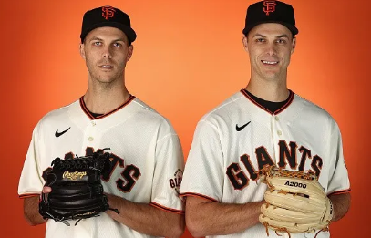
THE ROGERS TWINS – CHATFIELD H.S.
TAYLOR ROGERS
TYLER ROGERS

Slide 18
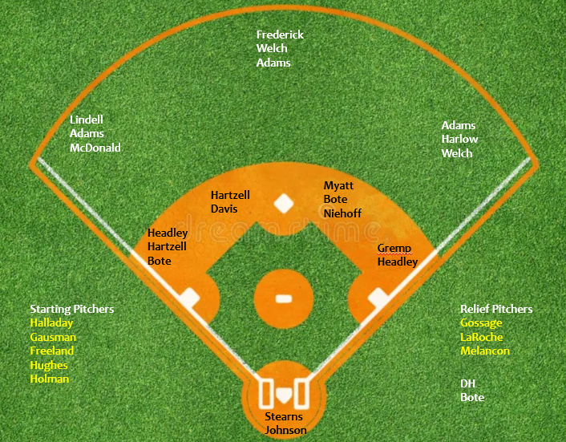
COLORADO NATIVES ALL-POSITION TEAM

Slide 19
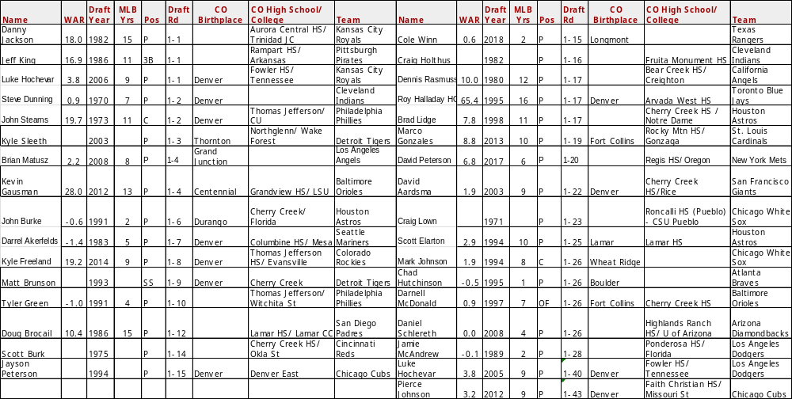
FIRST ROUND DRAFT PICKS

Slide 20
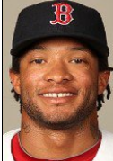
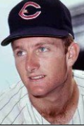
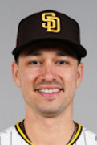
FIRST ROUND DRAFT PICKS
DARNELL McDONALD – (2004-2013) - CHERRY CREEK H.S.
STEVE DUNNING - (1970 – 1977) – DENVER
MARCO GONZALES – (2014-2024) - ROCKY MTN HS, FORT COLLINS

Slide 21
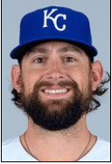
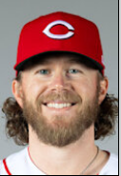
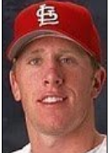
FIRST ROUND DRAFT PICKS
LUKE HOCHEVAR – (2007-2016) - DENVER
PIERCE JOHNSON – (2017-PRESENT) - DENVER
CHAD HUTCHINSON – (2001) - BOULDER

Slide 22
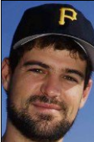
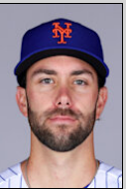
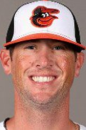
FIRST ROUND DRAFT PICKS
JEFF KING (1989-1999) – RAMPART HS , CO SPRINGS
DAVID PETERSON (2020-PRESENT) – REGIS JESUIT HS, AURORA
BRIAN MATUSZ (2009-2016) – GRAND JUNCTION

Slide 23
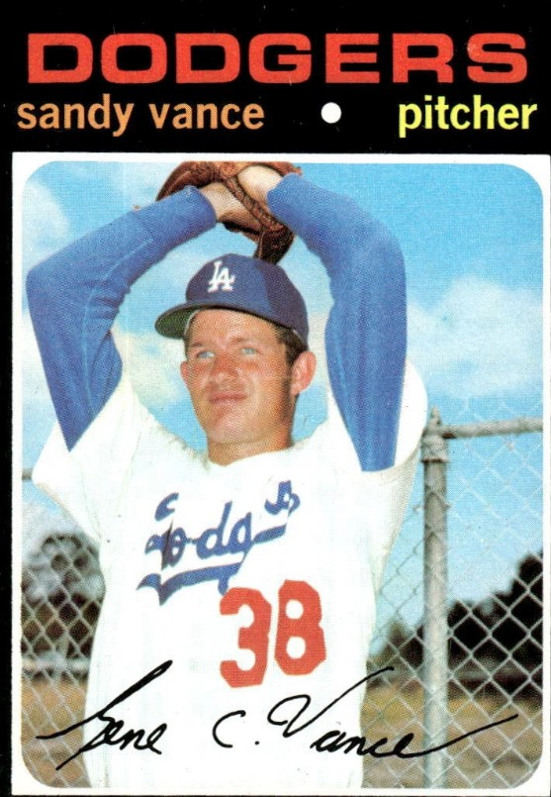
SANDY VANCE
FIRST PLAYER EVER DRAFTED OUT OF COLORADO
1st draft pick from CO in ‘65. Drafted 4 times in 2nd round, 31, 32, 33, 33, before signing with the Dodgers in 1968.
Born in Lamar. Made his MLB debut in 1970 and put up an impressive stat line: 115 IP, 3.13 ERA, 1.27 WHIP and was named the Dodgers rookie of the year. However, he struggled in 1971 dealing with an arm injury, which proved to be his last season in the bigs.

Slide 24
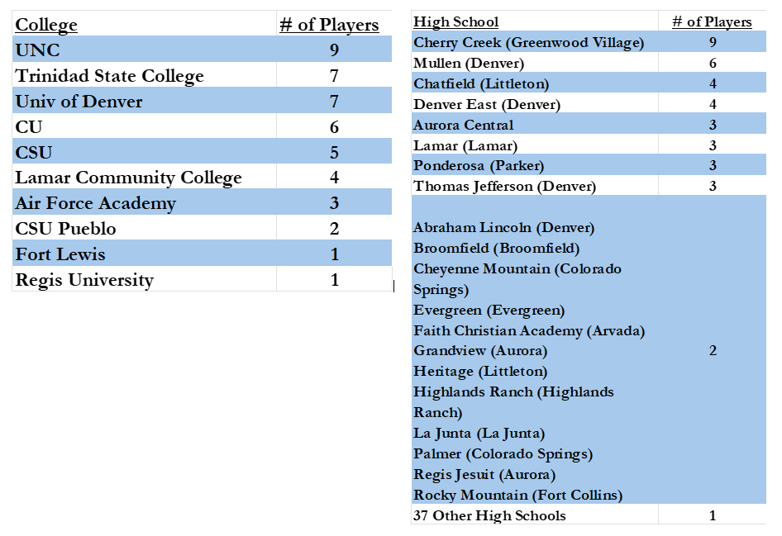
PLAYERS FROM EACH SCHOOL

Slide 25
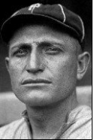
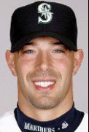
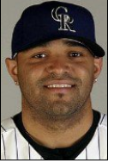
NOTABLE NATIVE AND HIGH SCHOOL PLAYERS
BERT NIEHOFF - (1913-1918) – LOUISVILLE, CO
DAVID AARDSMA (2004-2015) – CHEERY CREEK HS, GREENWOOD VILLAGE
SHAWN CHACON - (2001-2008) – GREELEY CENTRAL HS

Slide 26
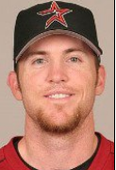
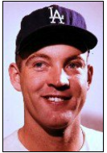
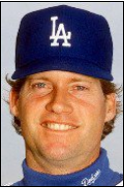
NOTABLE NATIVE AND HIGH SCHOOL PLAYERS
BRAD LIDGE (2002-2012) – CHERRY CREEK HS, GREENWOOD VILLAGE
STAN WILLIAMS (1958-1972) – EAST HS, DENVER
JAY HOWELL (1980-1994) - FAIRVIEW HS, BOULDER

Slide 27
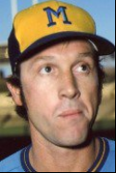

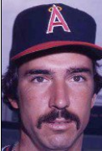
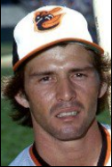
NOTABLE NATIVE AND HIGH SCHOOL PLAYERS
JACK LIND – (1974-1975) – DENVER
DAVE LaROCHE – (1970-1983) – COLORADO SPRINGS
LARRY HARLOW – (1975-1981) – COLORADO SPRINGS

Slide 28
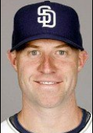
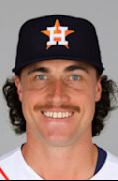
NOTABLE NATIVE AND HIGH SCHOOL PLAYERS
KEVIN KOUZMANOFF – (2006-2014) – EVERGREEN HS
BRYAN KING – (2024-PRESENT) – LITTLETON, CO

Slide 29

THEODORE “BUBBLES” ANDERSON
The only Colorado-born baseball player to play in the Negro Leagues. Began his career at the age of 17, just two years after the Negro Leagues were established in 1920.
He played second base and catcher for the Kansas City Monarchs in 1922-23. He moved east and started the season playing second base with the Washington Potomacs and later for the Birmingham Black Barons in 1924. Finally, he finished his career with the Indianapolis ABCs in 1925.
Inducted into the Colorado Sports Hall of Fame in 2025.

Slide 30


OURAY’S “SMOKY” JOE WOOD
Field of Dreams
Universal Pictures - 1989

Slide 31


OURAY’S “SMOKY” JOE WOOD
His Brilliant 1912 Season

Slide 32

OURAY’S “SMOKY” JOE WOOD
Ouray Baseball

Slide 33


OURAY’S “SMOKY” JOE WOOD
Career Highlights

Slide 34


OURAY’S “SMOKY” JOE WOOD
Career Highlights

Slide 35

OURAY’S “SMOKY” JOE WOOD
Career Highlights

Slide 36

OURAY’S “SMOKY” JOE WOOD
Career Statistics

Slide 37



OURAY’S “SMOKY” JOE WOOD
Coaching at Yale

Slide 38



OURAY’S “SMOKY” JOE WOOD
Notoriety

Slide 39


OURAY’S “SMOKY” JOE WOOD
Plaque Dedication

Slide 40
Why have pitchers been so much more prevalent and successful coming out of CO than hitters
For perspective of where Colorado stands with quantity and quality of players, comparison to Nebraska players in MLB
2025 Draft
  Christian Foutch of Chatfield was selected in the fifth round
  Dallas Macias of Regis Jesuit went in the 15th round
  Easton Marks of Arapahoe was selected by the Colorado Rockies in the 19th round
Upcoming 2026 CO Senior class D1 commitments

Slide 41
TOP COLORADO SENIOR PLAYERS FOR 2026
Ethan Wachsmann, Sr. RHP, Grandview (Wake Forest)
Cooper Vais, Jr. RHP/SS/CF, Arvada West (Texas)
Gunnar Garrison, Sr. RHP, Eaton (Arizona State)
Hudson Alpert, Sr. RHP/INF, Regis Jesuit (Vanderbilt)
Cole Teltschik, Sr. C/MIF, Discovery Canyon (Missouri State)
Luc Gaca Thiele, Sr. INF/OF, Fossil Ridge (Columbia)
Alex King, Sr. RHP/INF, Mountain Vista (Xavier)
Bret Baldwin, Jr. SS, Ralston Valley (Washington)
Maddox Burnett, Sr. RHP/UTL, Erie (BYU)
Max Goldberg, Sr. LHP, Cherry Creek (Boston College)
Jackson Bernosky, Jr. C/INF, Grandview (Gonzaga)
Aaron Jaquez, Sr. RHP, Falcon (McLennan Community College)
Chase Massey, Sr. SS/OF, Regis Jesuit (Boston College)
Jake Watts, Jr. RHP, Ralston Valley (Evansville)
Jacob Olson, Sr. OF/1B, Regis Jesuit (Oregon)
Jackson Crawford, Jr. OF/1B, Mountain Vista (Southern California)
Colten Smith, Jr. RHP/OF, Legend (BYU)
Isaac Lockwood, Jr. RHP, Mead (Santa Clara)
Cory Dean Carver, Sr. SS, Montezuma-Cortez (Navy).

